Slide 1
Kinematics and Dynamics of Robots
Spring Semester 2021
Lecturer: Yoav Golan

Slide 2
Class Problem #3
P
L₃
θ₂
L₂
θ₃
y₀
L₁
θ₁=30º θ₂=15º θ₃=35º
L₁=400mm L₂=300mm L₃=200mm
θ₁
x₀
P=?

Slide 3
Forward Kinematics
P
L₃
θ₂
L₂
θ₃
y₀
L₁
θ₁
x₀
P(θ₁, θ₂, θ₃)=?

Slide 4
Forward Kinematics Demo
P
L₃
θ₂
L₂
θ₃
y₀
L₁
θ₁
x₀
P(θ₁, θ₂, θ₃)=?

Slide 5
Euler Angles
3D angular pose:
3 angles = 3 rotations
Notes:
Rotating by X, Y, Z gives a matrix with a lot of dependancies

Slide 6
Euler Angles
3 angles = 3 rotations
RPY
ZYZ
Notes:
Rotating by X, Y, Z gives a matrix with a lot of dependancies

Slide 7
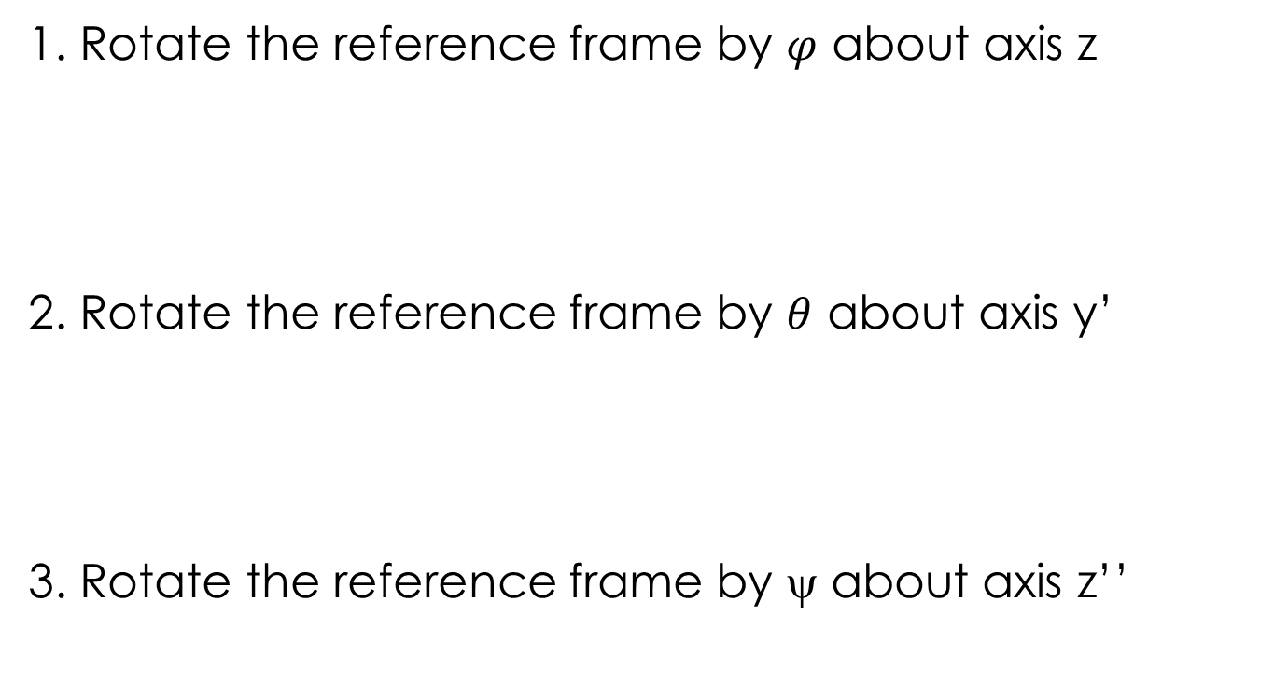
ZYZ Euler Angles
1. Rotate the reference frame by $φ$ about axis z
2. Rotate the reference frame by $θ$ about axis y’
3. Rotate the reference frame by ψ about axis z’’

Slide 8
ZYZ Euler Angles

Slide 9
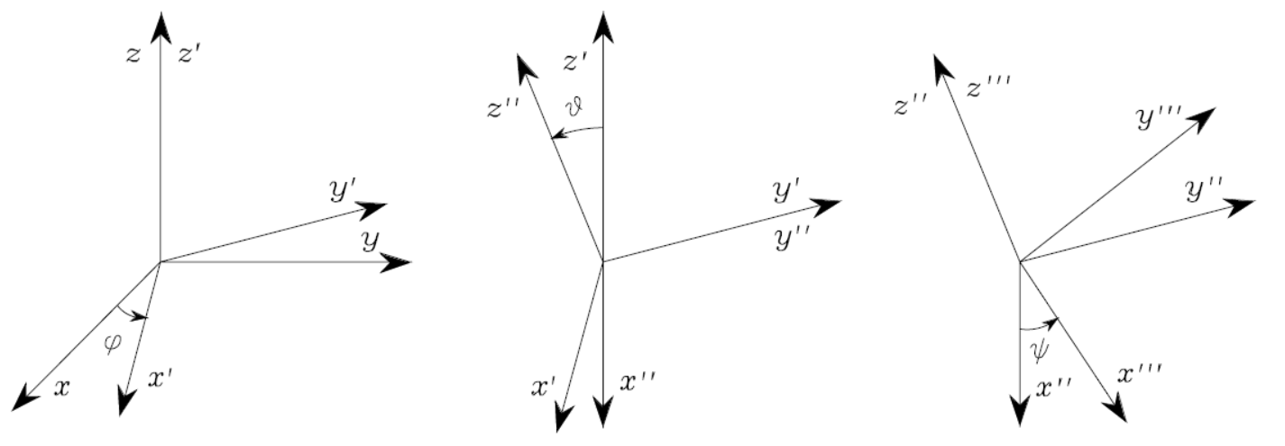

ZYZ Euler Angles
$$θ$$

Slide 10
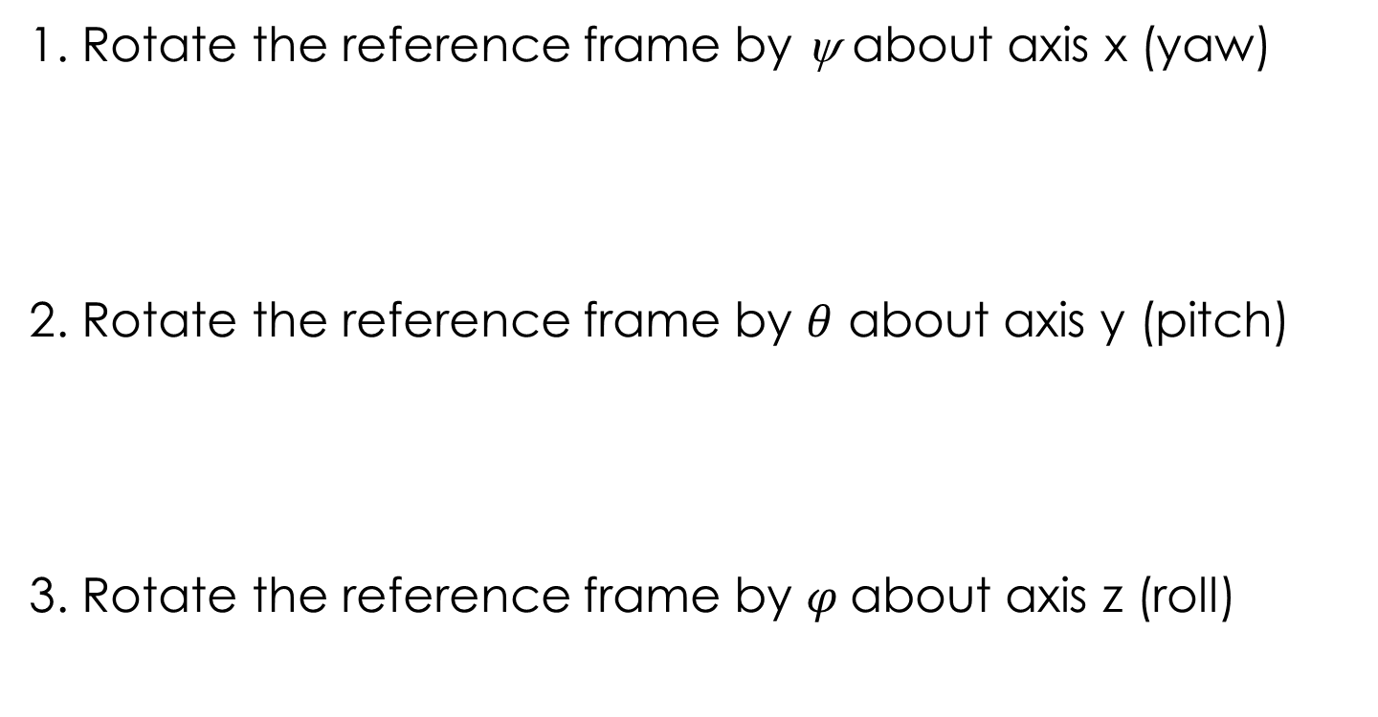
RPY Euler Angles
1. Rotate the reference frame by ψ about axis x (yaw)
2. Rotate the reference frame by $θ$ about axis y (pitch)
3. Rotate the reference frame by $φ$about axis z (roll)

Slide 11
Rotation Demo
Notes:
RoboDK reference frame file here

Slide 12
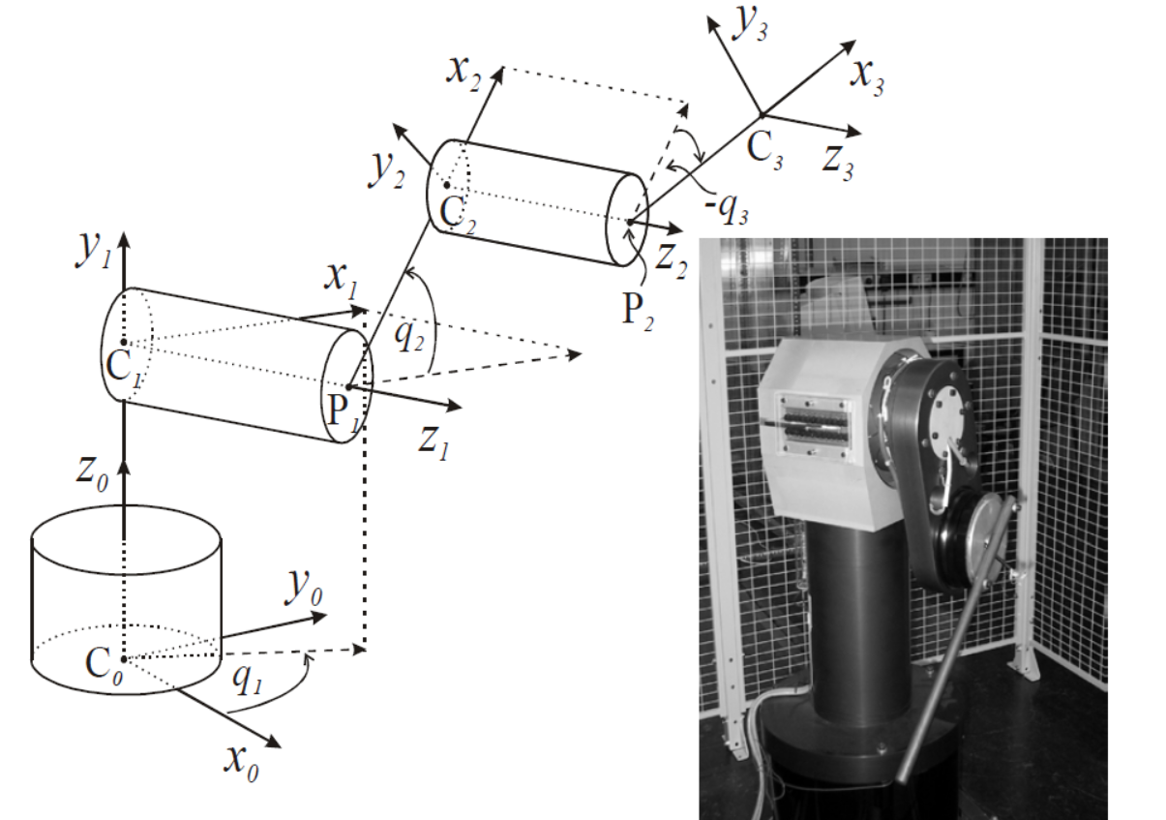
Forward Kinematics

Slide 13
Forward Kinematics
=Z_{0.5}
y_{0.5}
x_{0.5}

Slide 14
Forward Kinematics
Z_{0.75}=
y_{0.75}
x_{0.75}
=Z_{0.5}
y_{0.5}
x_{0.5}

Slide 15
Forward Kinematics
Z_{0.75}=
y_{0.75}
x_{0.75}
=Z_{0.5}
y_{0.5}
x_{0.5}

Slide 16
Forward Kinematics
Z_{0.75}=
y_{0.75}
y_{1.5}
x_{0.75}
x_{1.5}
=Z_{1.5}
=Z_{0.5}
y_{0.5}
x_{0.5}

Slide 17
Forward Kinematics
Z_{0.75}=
y_{0.75}
y_{1.5}
x_{1.75}
x_{0.75}
x_{1.5}
y_{1.75}
=Z_{1.5}
=Z_{0.5}
y_{0.5}
x_{0.5}

Slide 18
Forward Kinematics
x_{2.5}
y_{2.75}
y_{2.5}
x_{2.75}
Z_{0.75}=
y_{0.75}
y_{1.5}
=Z_{2.5}
x_{1.75}
x_{0.75}
x_{1.5}
y_{1.75}
=Z_{1.5}
=Z_{0.5}
y_{0.5}
x_{0.5}

Slide 19
Forward Kinematics
x_{2.5}
y_{2.75}
y_{2.5}
x_{2.75}
Z_{0.75}=
y_{0.75}
y_{1.5}
=Z_{2.5}
x_{1.75}
x_{0.75}
x_{1.5}
y_{1.75}
=Z_{1.5}
=Z_{0.5}
y_{0.5}
x_{0.5}

Slide 20
Forward Kinematics
x_{2.5}
y_{2.75}
y_{2.5}
x_{2.75}
Z_{0.75}=
y_{0.75}
y_{1.5}
=Z_{2.5}
x_{1.75}
x_{0.75}
x_{1.5}
y_{1.75}
=Z_{1.5}
=Z_{0.5}
y_{0.5}
x_{0.5}

Slide 21
Denavit - Hartenberg Method
A convention for determining joint frames
An industry “standard”
Results in easy homogenous transformations

Slide 22
Denavit - Hartenberg Parameters
The DH parameters are the relationship between two subsequent reference frames
The parameters are:
Joint angle
Link twist
Link length
Link offset

Slide 23
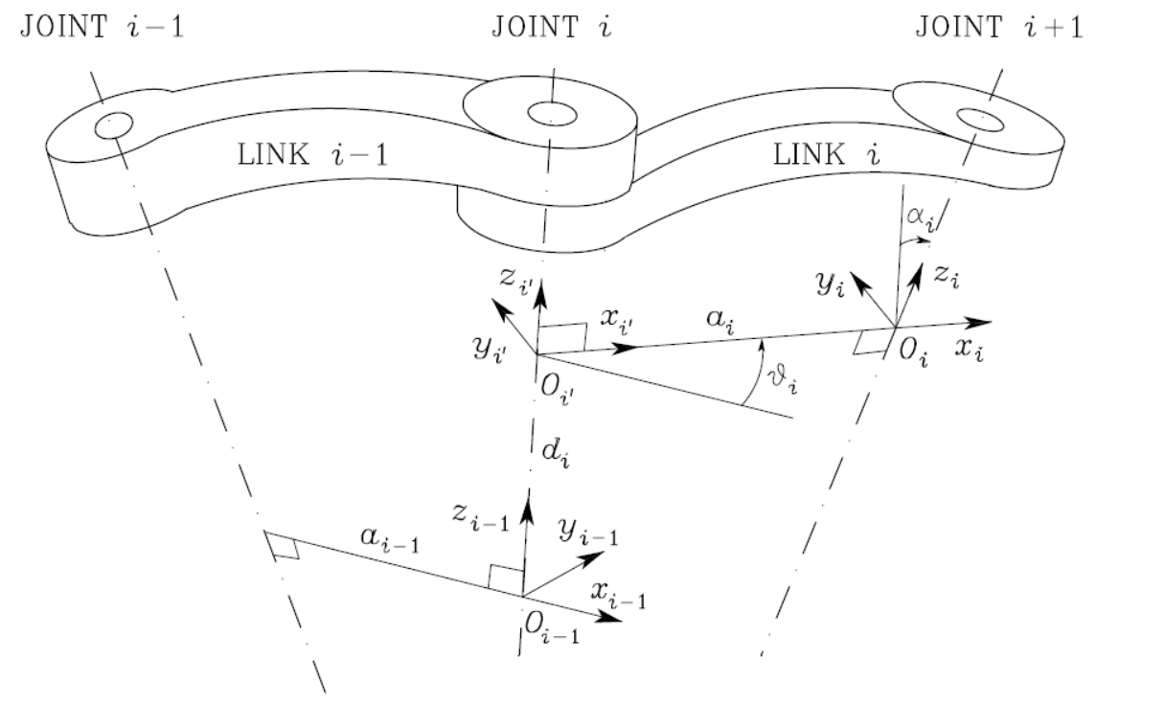
Denavit - Hartenberg Parameters
Joint angle 2. Link twist
3. Link length 3. Link offset

Slide 24
Drawing DH Frames
Rules:
There must be at least n+1 frames for n joints. The end effector must have a frame.
The Z axis must be the axis of revolution or the direction of prismatic movement

Slide 25
Drawing DH Frames
Rules:
3. The X axis must be perpendicular to the Z axis of the frame before it
4. The X axis must intersect the Z axis of the frame before it
5. The Y axis is drawn by the right-hand rule

Slide 26
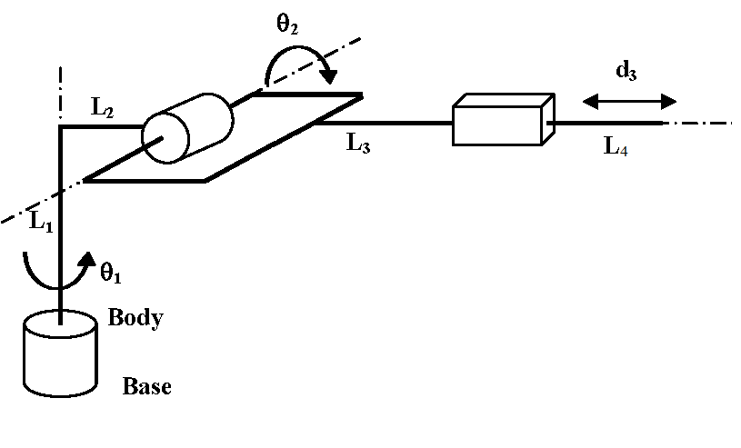
Drawing DH Frames

Slide 27
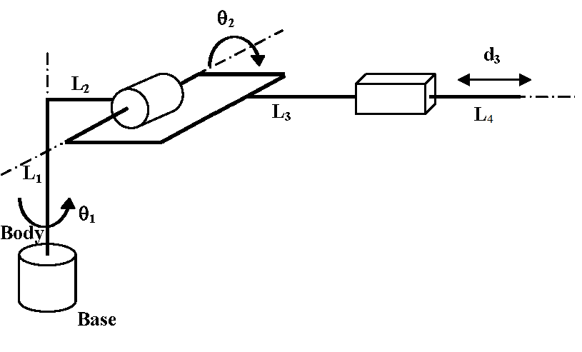
Drawing DH Frames
Rule #1: 4 frames
Rule #2:
Z₁
Z₃
Z₂
Z₀

Slide 28
Drawing DH Frames
Rule #3:
4 frames
X₂
X₃
Z₁
Z₃
X₁
Z₂
Z₀
X₀

Slide 29
Drawing DH Frames
Rule #4:
4 frames
X₂
X₃
Z₁
Z₃
X₁
Z₂
Z₀
X₀

Slide 30
Drawing DH Frames
Rule #5:
4 frames
X₂
X₃
Z₁
Z₃
y₂
Z₂
X₁
y₁
y₃
Z₀
y₀
X₀

Slide 31
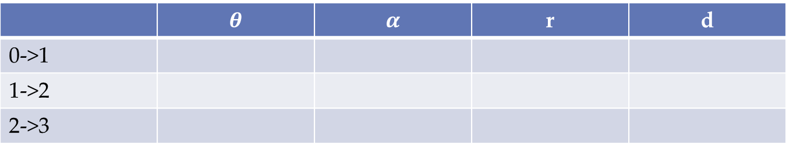
Deriving the DH Parameters
 | $$θ$$ | $$α$$ | r | d
0->1
1->2
2->3

Slide 32
Deriving the DH Parameters
Joint angle
The amount we have to rotate the frame i-1 about the Z_{i-1} axis so that X_{i-1} and X_{i} are parallel
PLUS
the revolution of a revolute joint

Slide 33



Deriving DH Parameters
Joint angle
4 frames
X₂
X₃
Z₁
Z₃
y₂
Z₂
X₁
y₁
y₃
 | $$θ$$ | $$α$$ | r | d
0->1 i=1
1->2 i=2
2->3 i=3
Z₀
0+$θ_{1}$
y₀
-90+$θ_{2}$
X₀
0

Slide 34
Deriving the DH Parameters
Joint twist
The amount we have to rotate the frame i-1 about the X_{i} axis so that Z_{i-1} and Z_{i} are parallel

Slide 35
Deriving DH Parameters
Joint Twist
4 frames
X₂
X₃
Z₁
Z₃
y₂
Z₂
X₁
y₁
y₃
 | $$θ$$ | $$α$$ | r | d
0->1 i=1
1->2 i=2
2->3 i=3
Z₀
0+$θ_{1}$
-90
y₀
-90+$θ_{2}$
-90
X₀
0
0

Slide 36
Deriving the DH Parameters
Link Length
The distance from frame {i} to frame {i-1} in the X_{i} axis direction

Slide 37
Deriving DH Parameters
Link Length
4 frames
X₂
X₃
Z₁
Z₃
y₂
Z₂
X₁
y₁
y₃
 | $$θ$$ | $$α$$ | r | d
0->1 i=1
1->2 i=2
2->3 i=3
Z₀
0+$θ_{1}$
-90
L₂
y₀
-90+$θ_{2}$
-90
0
X₀
0
0
0

Slide 38
Deriving the DH Parameters
Link Offset
The distance from frame {i} to frame {i-1} in the Z_{i-1} axis direction

Slide 39
Deriving DH Parameters
Link Length
4 frames
X₂
X₃
Z₁
Z₃
y₂
Z₂
X₁
y₁
y₃
 | $$θ$$ | $$α$$ | r | d
0->1 i=1
1->2 i=2
2->3 i=3
Z₀
0+$θ_{1}$
-90
L₂
L₁
y₀
-90+$θ_{2}$
-90
0
0
X₀
0
0
0
L₃+L₄+d₃

Slide 40
Using DH Parameters

Slide 41
Using DH Parameters

Slide 42
Using DH Parameters
Demo

Slide 43
Drawing DH Frames
Rules:
There must be at least n+1 frames for n joints. The end effector must have a frame.
The Z axis must be the axis of revolution or the direction of prismatic movement

Slide 44
Drawing DH Frames
Rules:
3. The X axis must be perpendicular to the Z axis of the frame before it
4. The X axis must intersect the Z axis of the frame before it
5. The Y axis is drawn by the right-hand rule

Slide 45
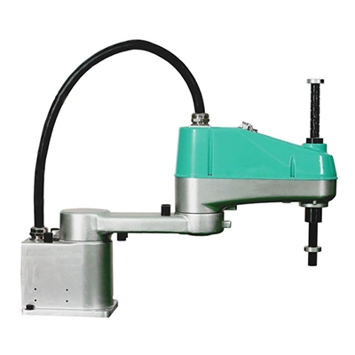
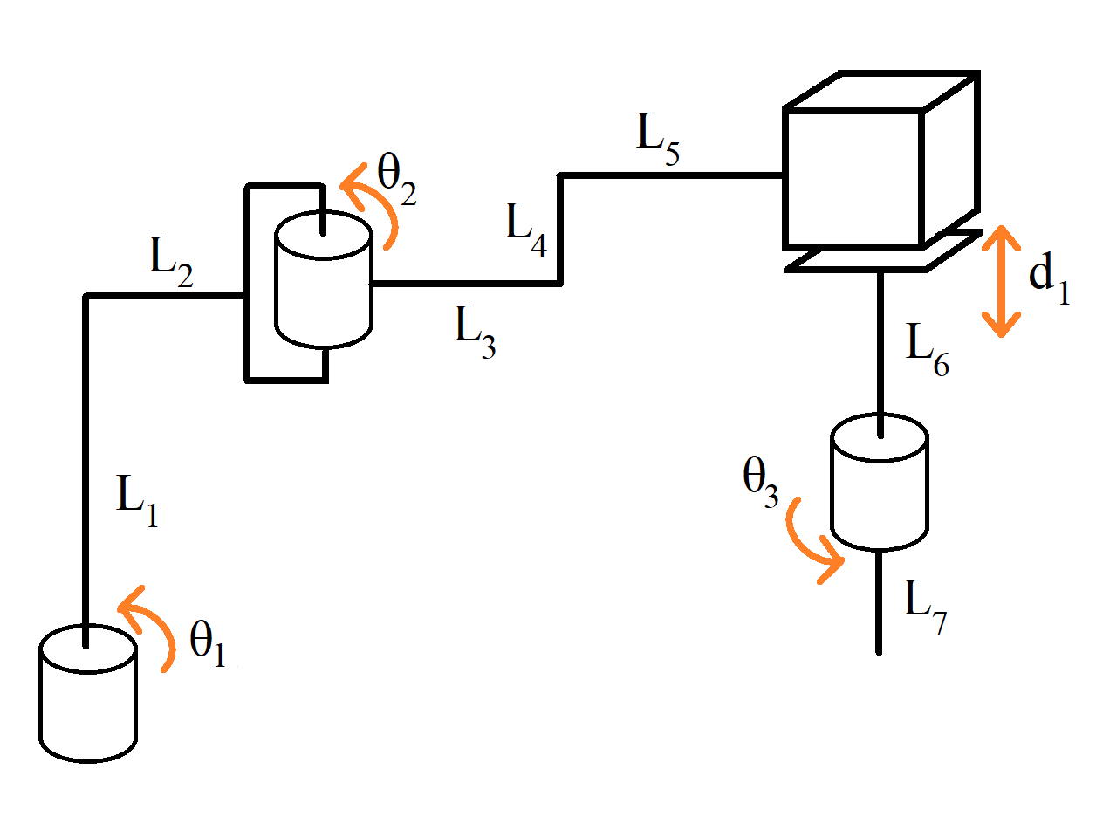
Drawing DH Frames

